Slide 1

Pizza Sales Insights: A MySQL Analysis

Slide 2
Introduction
This project is a comprehensive analysis of pizza sales data, aiming to extract valuable insights and trends. Using MySQL as the database management system, this project explores various aspects of pizza sales, including customer preferences, sales patterns, and product performance. The analysis covers the sales data for the year 2015. The findings of this project can inform business decisions and strategies for pizza sales and marketing.

Slide 3


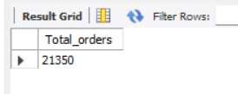
Q1. Retrieve the total number of orders placed.
The total number of orders for the year 2015 is 21,350.

Slide 4
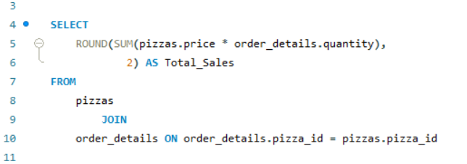
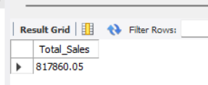
Q2. Calculate the total revenue generated from pizza sales.
The total revenue generated in the year 2015 is $817,860.

Slide 5
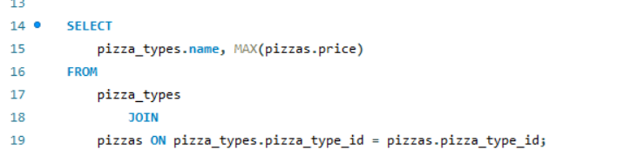
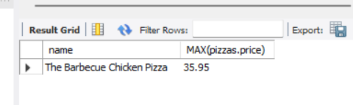
Q3.Identify the highest-priced pizza.
The highest-priced pizza costs $35.95.

Slide 6
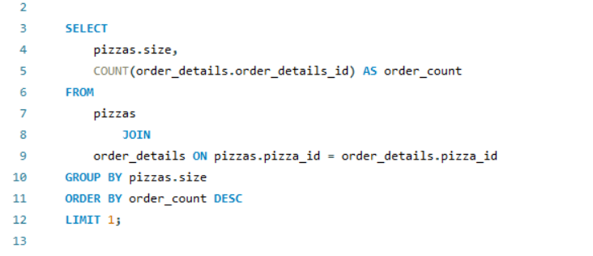
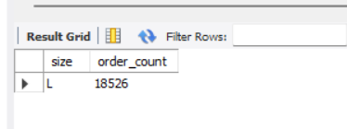
Q4.Identify the most common pizza size ordered.
The most common size pizza orderd is Large with a total of 18,526 orders in 2015.

Slide 7
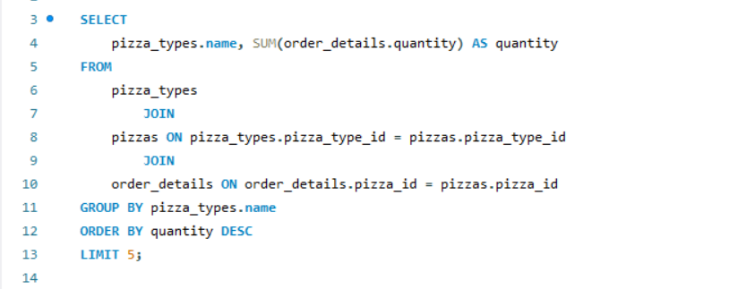
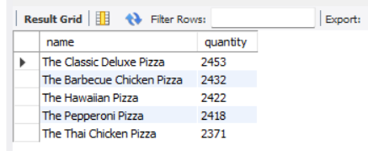
Q5. List the top 5 most ordered pizza types along with their quantities.
These are the top 5 most ordered pizza types along with their quantities.

Slide 8
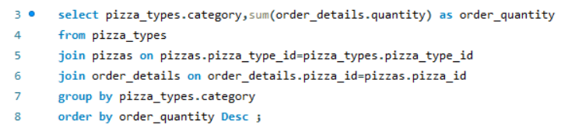
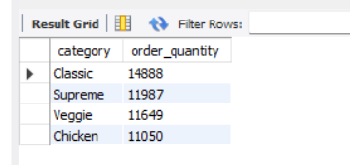
Q6. Join the necessary tables to find the total quantity of each pizza category.
These are the quantities for each pizza category.

Slide 9
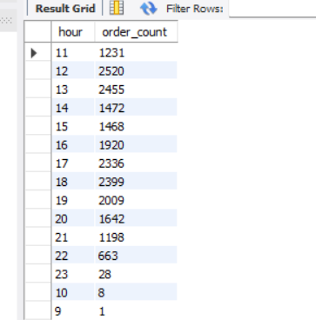
Q7. Determine the distribution of orders by hour of the day.
This is the hour-wise distribution of pizza orders today.

Slide 10

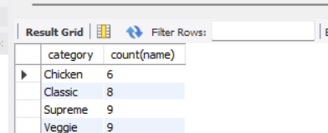
Q8. Join the relevent tables to find the category-wise distribution of pizzas.
These are the numbers of varieties in each type of pizza.

Slide 11
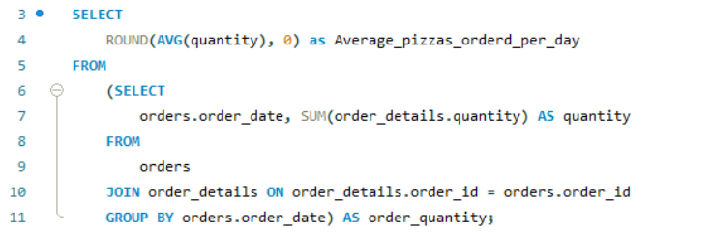

Q9. Group the orders by date and calculate the average number of pizzas ordered per day.
The average number of pizzas ordered per day is 138.

Slide 12
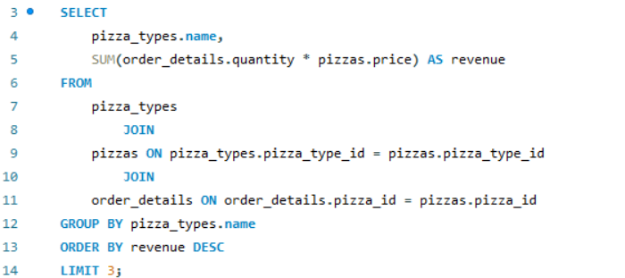
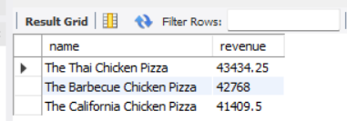
Q10 Determine the top 3 most ordered pizza types based on revenue.
These are the top 3 pizzas that generate most of the revenue.

Slide 13
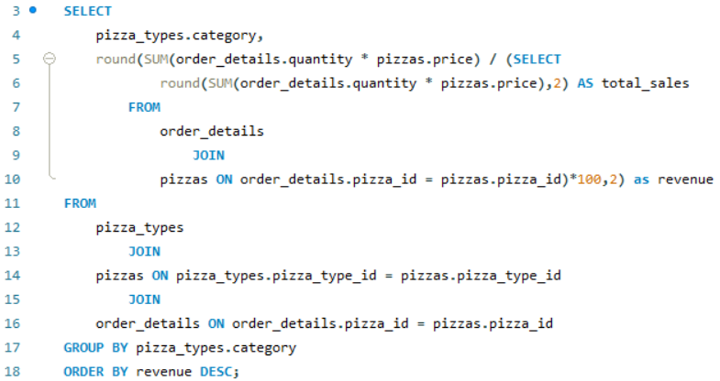
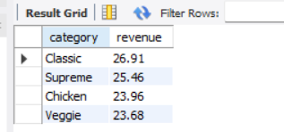
Q11.Calculate the percentage of contribution of each pizza type of total revenue.
Each pizza type contributes this percentage to the total revenue.

Slide 14
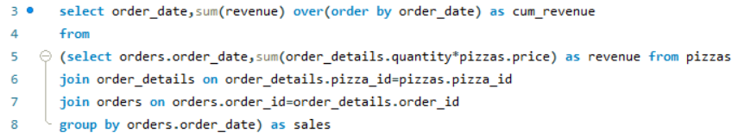
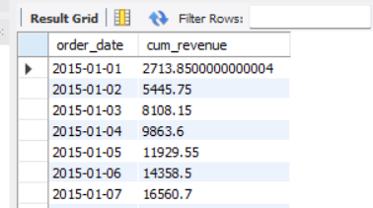
Q12. Analyze the cumulative revenue generated over time.
Above are some records of cumulative revenue generated over the days.

Slide 15
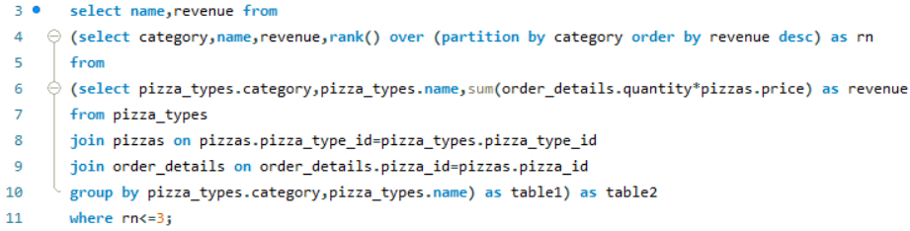
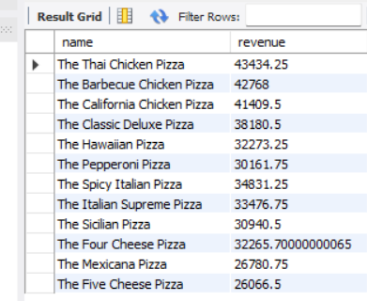
Q13. Determine the top 3 most ordered pizza types based on revenue for each pizza category.
Above are the top 3 most ordered pizza types based on revenue for each pizza category.

Slide 16
Slide Title
Product A
Product B
Feature 1
Feature 2
Feature 3
Feature 1
Feature 2
Feature 3

